Slide 1
Neutron-matter interaction
K_{f}=K_{i}+Q
E_{f}=E_{i}+w
Material
2q
K_{i}, E_{i}
Q, w
(d=2p/Q)
K_{f}, E_{i}
Bragg's law (diffraction on structure – atoms separated by distance d)
$nλ=2π/{K_{i}}=2dsinθ$
Scattering law (intensity per solid angle and energy, dynamics)
$\frac{d^{2}σ}{dΩ{dE}_{f}}=\frac{K_{f}}{K_{i}}\left[\frac{σ}{4π}S\left(Q,ω\right)\right]$
Holy Book (Squires)
Dynamical structure factor S(Q,w) is characteristic of each material
Reflects ordering of matter (atom/molecule positions – movements - domains)

Slide 2
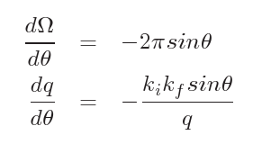
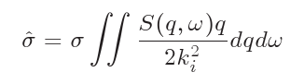
Computing the total scattering probability
The total scattering cross section is given in (Ω,E_{f}) space, but S is given in (q,ω)
A variable change must be done for the integration (Jacobian).
We like to play games
in (q,w) space
Ulrich
office
Effective cross section
in (q,w) space
Probability to transmit
$p=e^{−ρ\hat{σ}x}$
n
Scattering distribution
S(q,ω)
with importance sampling to
scatter preferably where S is large

Slide 3
Isotropic_Sqw syntax
Isotropic_Sqw(
Sqw_coh=FILE_COH,
Sqw_inc=FILE_INC,
radius=R,
height=H)
More component parameters can specify geometry, physical properties, ...
The data files specify the S(Q,w) or S(Q) values as a matrix with Q,w extent. Additional fields can be included as meta data (# lines).

Slide 4
Isotropic_Sqw data format
# Sqw data file for Isotropic_Sqw
# liquid He4: coherent part, no incoherent, atomic number 2
# Elementary Excitation Data by R.J. Donnelly et al., J. Low Temp. Phys., 44 (1981) 471
# WARNING: line width is constant, intensity is not right
#
# Physical parameters:
# V_rho 0.072 atom density per Angs^3
# weight 4.002 in [g/mol]
# density 0.4784 in [g/cm^3]
# sigma_abs 0.00747 absorption scattering cross section in [barn]
# sigma_coh 1.34 coherent scattering cross section in [barn]
# sigma_inc 0 incoherent scattering cross section in [barn]
# Temperature 2 in [K]
# classical 0 experimental, contains Bose factor
#
# q axis values
# vector of m values in Angstroem-1
0.001000 0.011000 0.02 …
# w axis values
# vector of n values in meV
0.001391 0.011391 0.021391 0.0313 …
# sqw values (one line per q axis value)
# matrix of S(q,w) values (m rows x n values), one line per q value
9.721422 10.599145 11.344954 …
He4_liq_coh.sqw

Slide 5
How to get S(q,w) data sets
Liq/Powder/Xtal
S(Q) or F(Q)
or S(|Q|,w)
Experiments
(corrected)
Inter-atomic
potential u(r)
Molecular
Dynamics
$\vec{F}=−∇u\left(\vec{r}\right)=−m\vec{γ}$
MDANSE
McStas
Sqw
R, v
S(|Q|,w)
Ab-initio MD
Pseudo-potential
Simulated
experiment
Ab-initio Lattice Dyn.
S(Q,w) 4D
MD step is done prior to the virtual experiment (NAMD, VASP, GROMACS, ...).
Computationally intensive (e.g. use clusters). Then use FFT(r,t)
McStas provides a few sample S(Q,w): Rb, Ge, H2O, D2O, D2, ...
Isotropic_Sqw: Handles elastic and inelastic for both coherent and incoherent channels

Slide 6
Sqw: a ’liquid’ TOF
Aim: A simple spectrometer (and diffractometer)
Create a new instrument from 'template (test)'.
Call it Liquid_simple and define input parameters (lambda=2.36, string coh=”Rb_liq_coh.sqw”, string inc=”Rb_liq_inc.sqw”)
Insert a Source_simple φ1cm sending λ=lambda with dλ/λ=1%. Focus onto a 1x1cm² area.
Insert an Isotropic_Sqw 3m away, using σ_{coh}=coh, σ_{inc}=inc with φ1cm x 5cm.

Slide 7
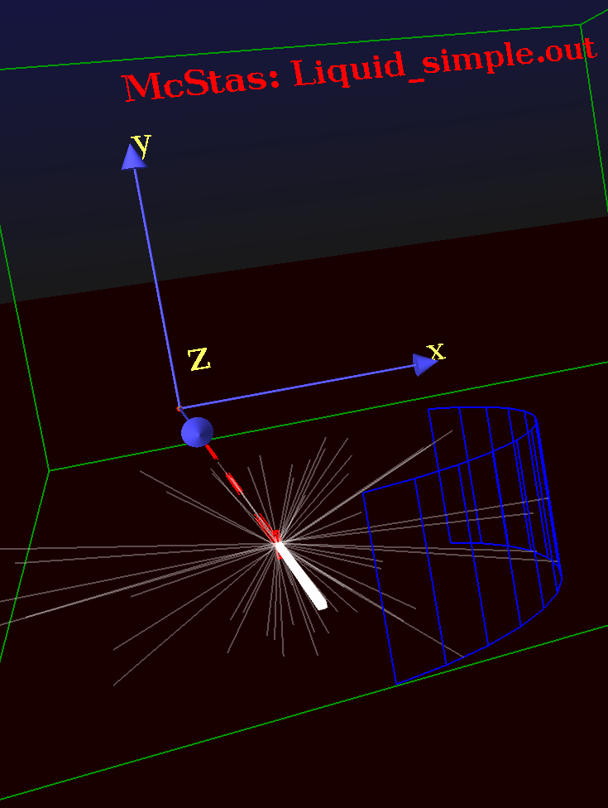
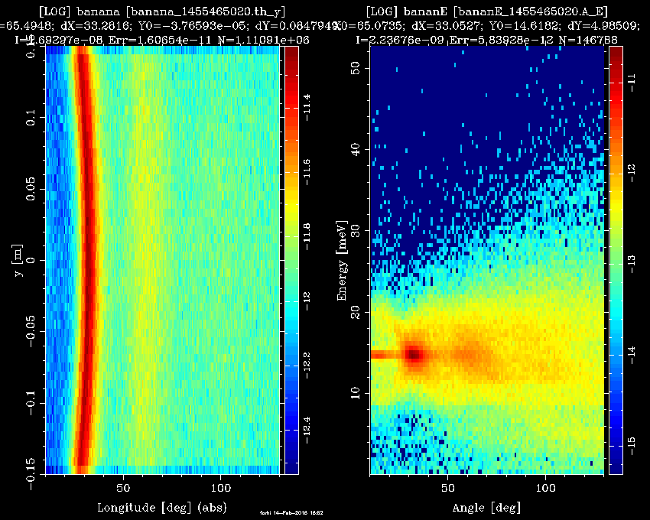
Sqw: a ’liquid’ TOF
Add a Monitor_nD cylindrical detector φ1m x 30cm, sensitive to (θ,y) for diffraction, centred on the sample, with 100 bins.
Add the same, but sensitive to (angle,energy) with automatic energy limits.
Save, run in Trace 3D to check geometry.
Run in Simulation/PGPLOT mode with 1e8 neutron events.
Plot results !
Comment on the diffraction pattern and the inelastic one.

Slide 8
Sqw: a ’liquid’ TOF: contributions
Insert an instrument variable in the DECLARE block, as 'flag_scat'.
DECLARE %{
int flag_scat=0;
%}
After the AT token of the 'sample', insert an EXTEND block that sets flag_scat to the number of SCATTERED events.
EXTEND %{
flag_scat=SCATTERED; // nb of scattered events
%}

